Slide 1

EE769: Introduction to Machine Learning
Banknote Authentication End to End Project
Project Viva Presentation
Dipanshu Sharma; 18B090004
Ayushman Dev Verma; 18B090002
BS Mathematics, Third Year

Slide 2
Project Objectives
Banknote forgery is an issue faced by many banking institutions around the globe. Our project is a step towards building a technique based on machine learning capable of detecting such forgery with high accuracy.
Our primary objective is to build a machine learning model based on some classification algorithms with high precision. Because detecting such forgeries by hand is a very lengthy process, our aim is to develop a model that can predict for a large chunk of data in a short space of time.
Secondly, our aim is to develop a user- friendly front-end, to enhance the usage and scale of our model.

Slide 3
Project Utility
The Gradient Boosting Model, which we selected for the final training and usage, had an accuracy of approximately 99.7%. Therefore our model can be used very efficiently for large-scale prediction as well.
Comparing this with real-life accuracy, we see that banks in India were only able to detect 95.7% of the forged notes in circulation in 2016-17. Therefore, our model can predict at not only a faster rate, but also more accurately than simply by hand.
Also, the front-end for the model can be operated very easily, and using it is faster than writing out an array in code, and then using the predict function over it.

Slide 4
Project Challenges
No challenges were faced while procuring the data from UCI Machine Learning Repository because it is very well documented and has been pre-cleaned to have no null/missing values.
We faced challenges in the development of front because we were new to these concepts. We went through various videos, websites and learn about it and finally used the flasgger library for this purpose and swagger for the API development.
We are planning to dockerize our model but due to several system compatibility challenges we dropped that idea and we restricted ourselves to visualize the front end over web, and we also used postman for a better experience in API development.

Slide 5
Source of Data and Features Information
Source:
UCI Machine Learning Repository; Volker Lohweg (University of Applied Sciences, Ostwestfalen-Lippe, volker.lohweg '@' hs-owl.de)
Link: https://archive.ics.uci.edu/ml/datasets/banknote+authentication
Feature Information:
Variance of Wavelet Transformed Image,
Skewness of Wavelet Transformed Image,
Kurtosis of Wavelet Transformed Image,
Entropy of Image and,
Class (0 or 1)*
*0 means forged note and 1 means authentic note

Slide 6
Procedure
Data Collection
Data Visualization and Pre-processing
Model Selection
Model Building and Validation
Pickle File
Front-End Development
Model Deployment
Postman API Development

Slide 7
Validity and Completeness of Conclusions
Classifier | Average Accuracy (approximate) | Maximum Accuracy (approximate)
Decision Trees | 0.978 | 0.982
Random Forest | 0.993 | 0.994
Gradient Boosting | 0.994 | 0.997
Logistic Regression | 0.989 | 0.990
As we can see, the Gradient Boosting model (with 150 estimators) resulted in the best performing model based on accuracy. Also, on comparing the average accuracy (averaged across tuned hyperparameter values), we can see that the gradient boosting classifier performs better even on average as compared to the other models. Also, after developing the front-end, we can see that using the complete end to end model is much more efficient, faster and accurate than simply checking forgery by hand or even by creating an array/dataframe of values, training the model, and finally predicting on the input array/dataframe.

Slide 8
Limitations
In the future, we can improve the performance by collecting more and more data and improving our image capturing methods, to make our measurements more accurate.
Also, we can make it more user-friendly for the front-end portion by hosting a separate mobile or web application. We can also use sophisticated deployment methods like Docker so that the application can be hosted on other systems. Moreover, we can make more options for inputting data, such as excel or text files.
In the model selection and training part, we can do a wider range of hyperparameter tuning, such as varying multiple hyperparameters over a larger range of values. Also, we can use more types of classifiers for our selection procedure. We can also use a combination of a variety of cross-validation metrics (such as Sensitivity or Specificity) because classifying a forged note as authentic is more costly than classifying an authentic note as forged.

Slide 9
Statement of Contributions
Dipanshu Sharma was responsible for the project's conception, data collection, cleaning, pre-processing, and creating the pickle file. (5-6 hours)
Ayushmaan Dev Verma carried out data visualisation, model selection, hyperparameter tuning and model testing. (8-9 hours)
Also, Dipanshu Sharma was responsible for the front-end development using Flask and Flasgger. (9-10 hours)
Ayushmaan was responsible for the Postman API Development and the project report-writing as well. (6-7 hours)
Both worked on the video-making and editing together. (6-7 hours)

Slide 10
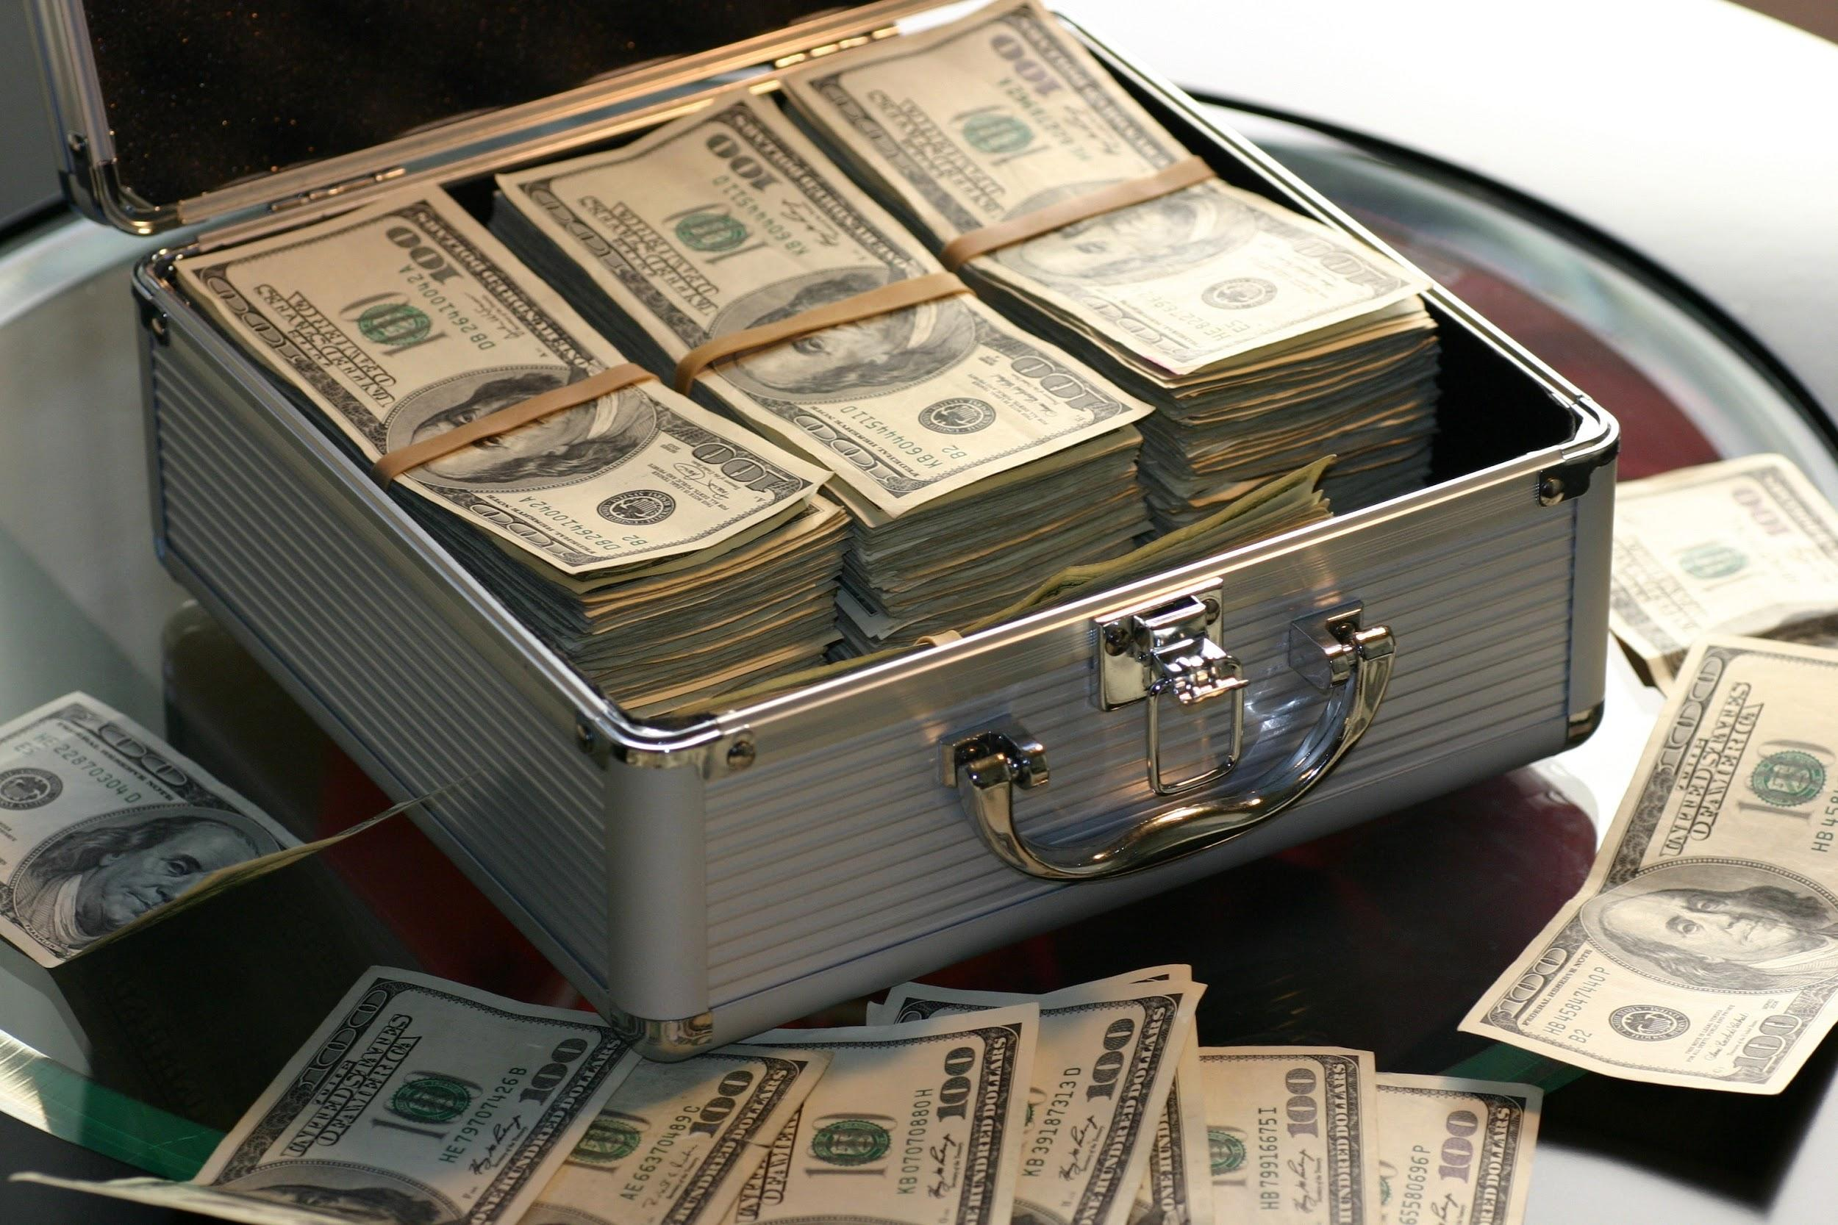
THANK YOU !!!

